Slide 1
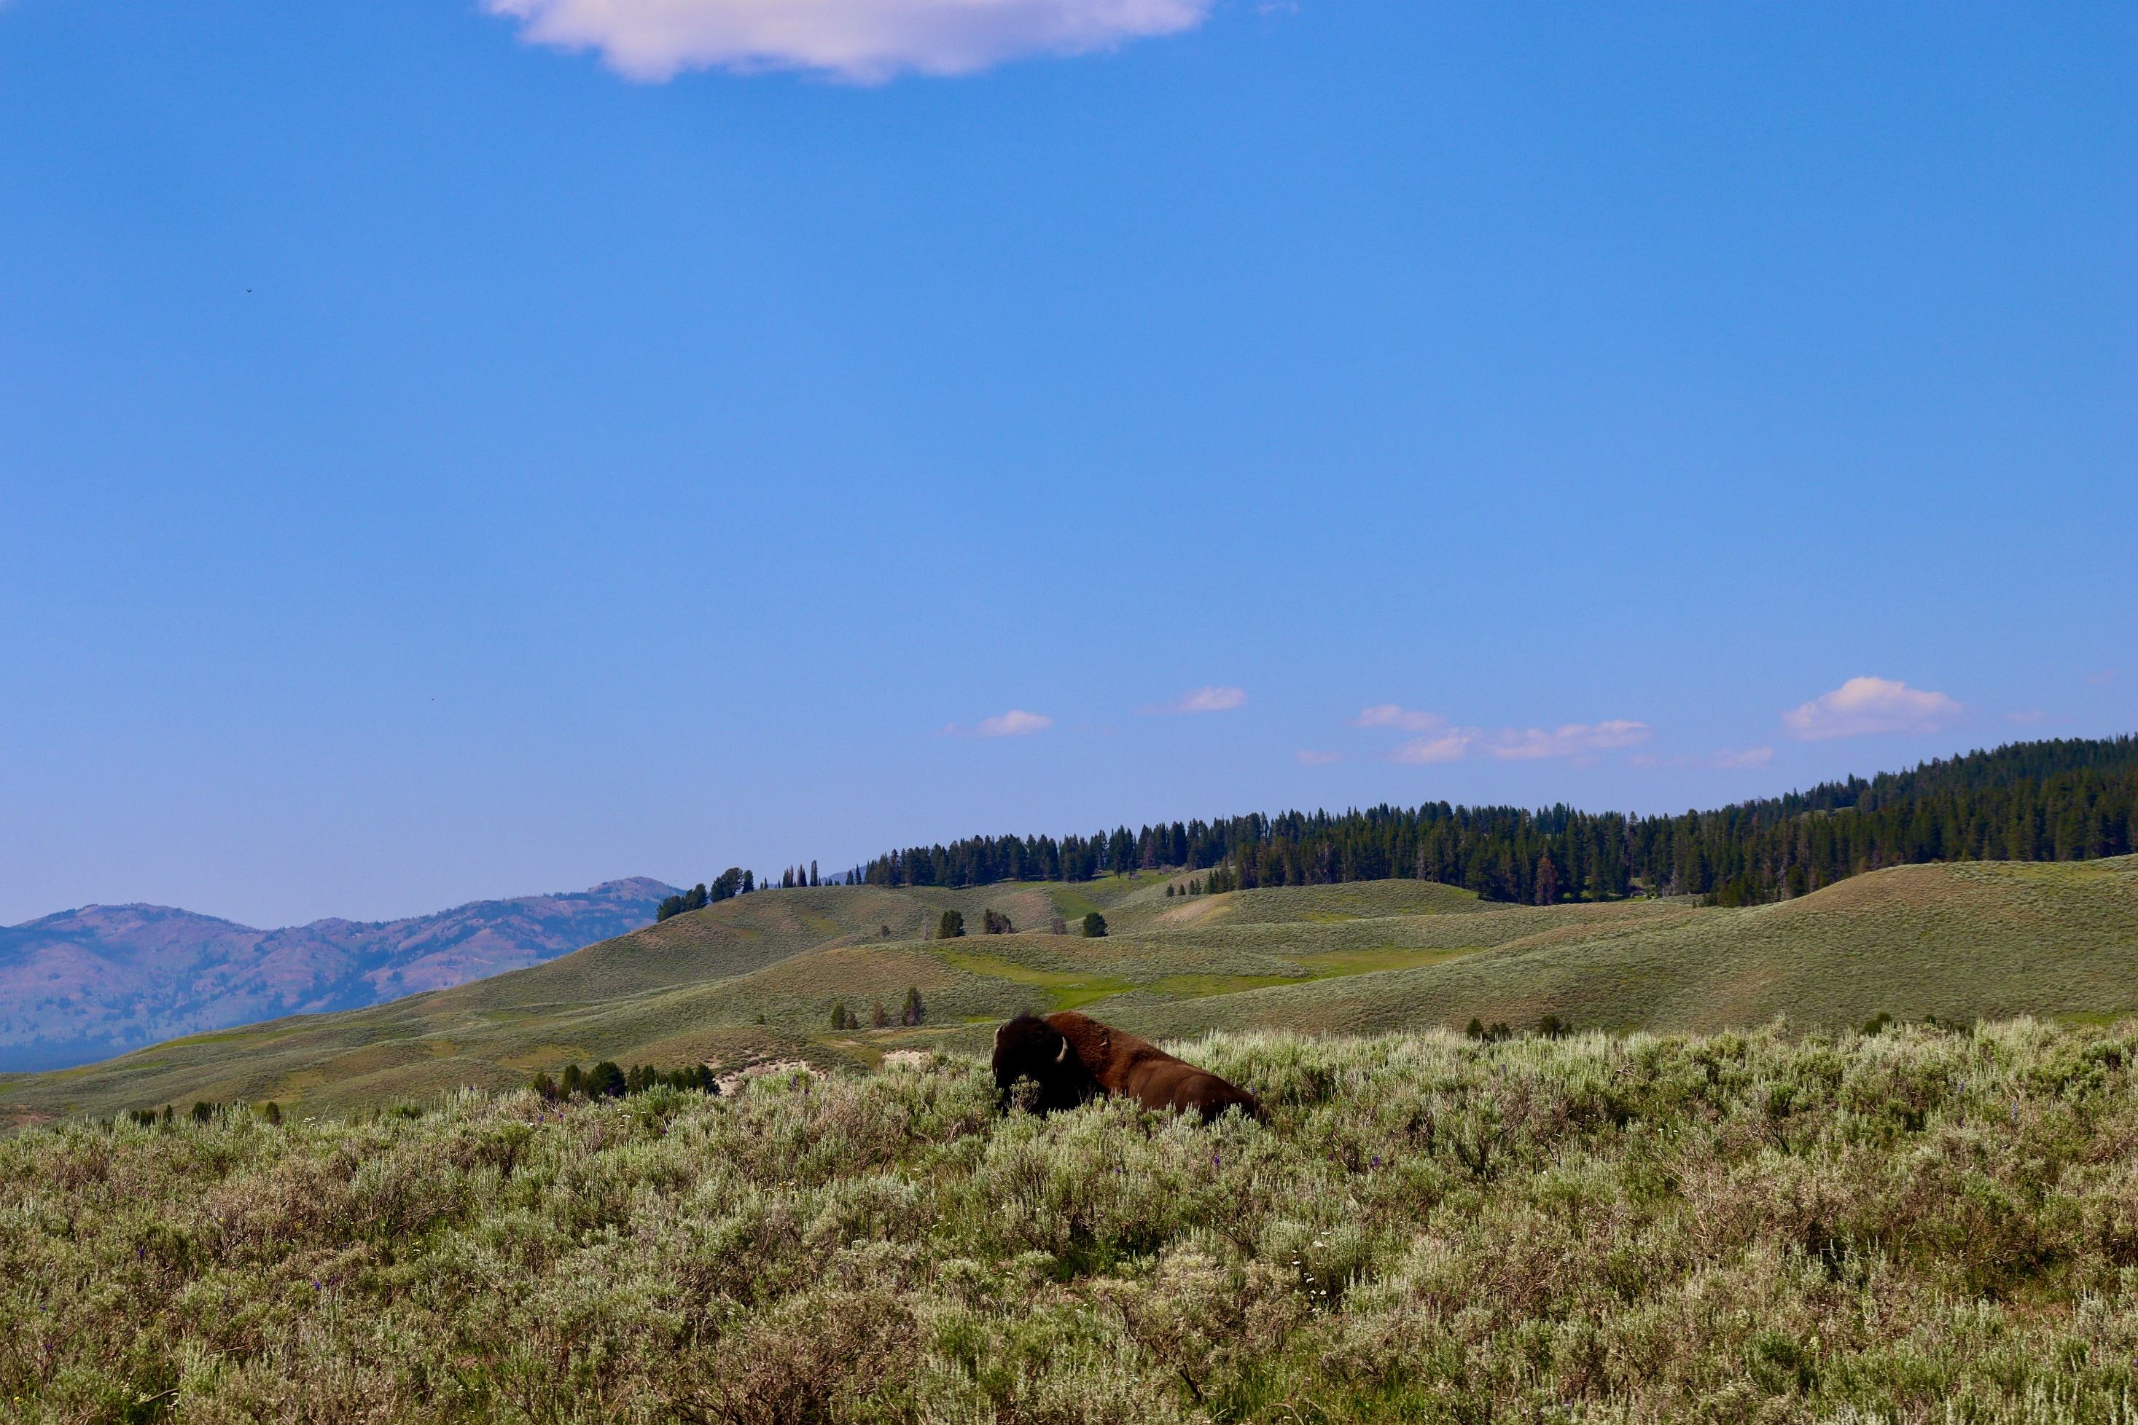
Created by
Faatimah
Majothi

Slide 2

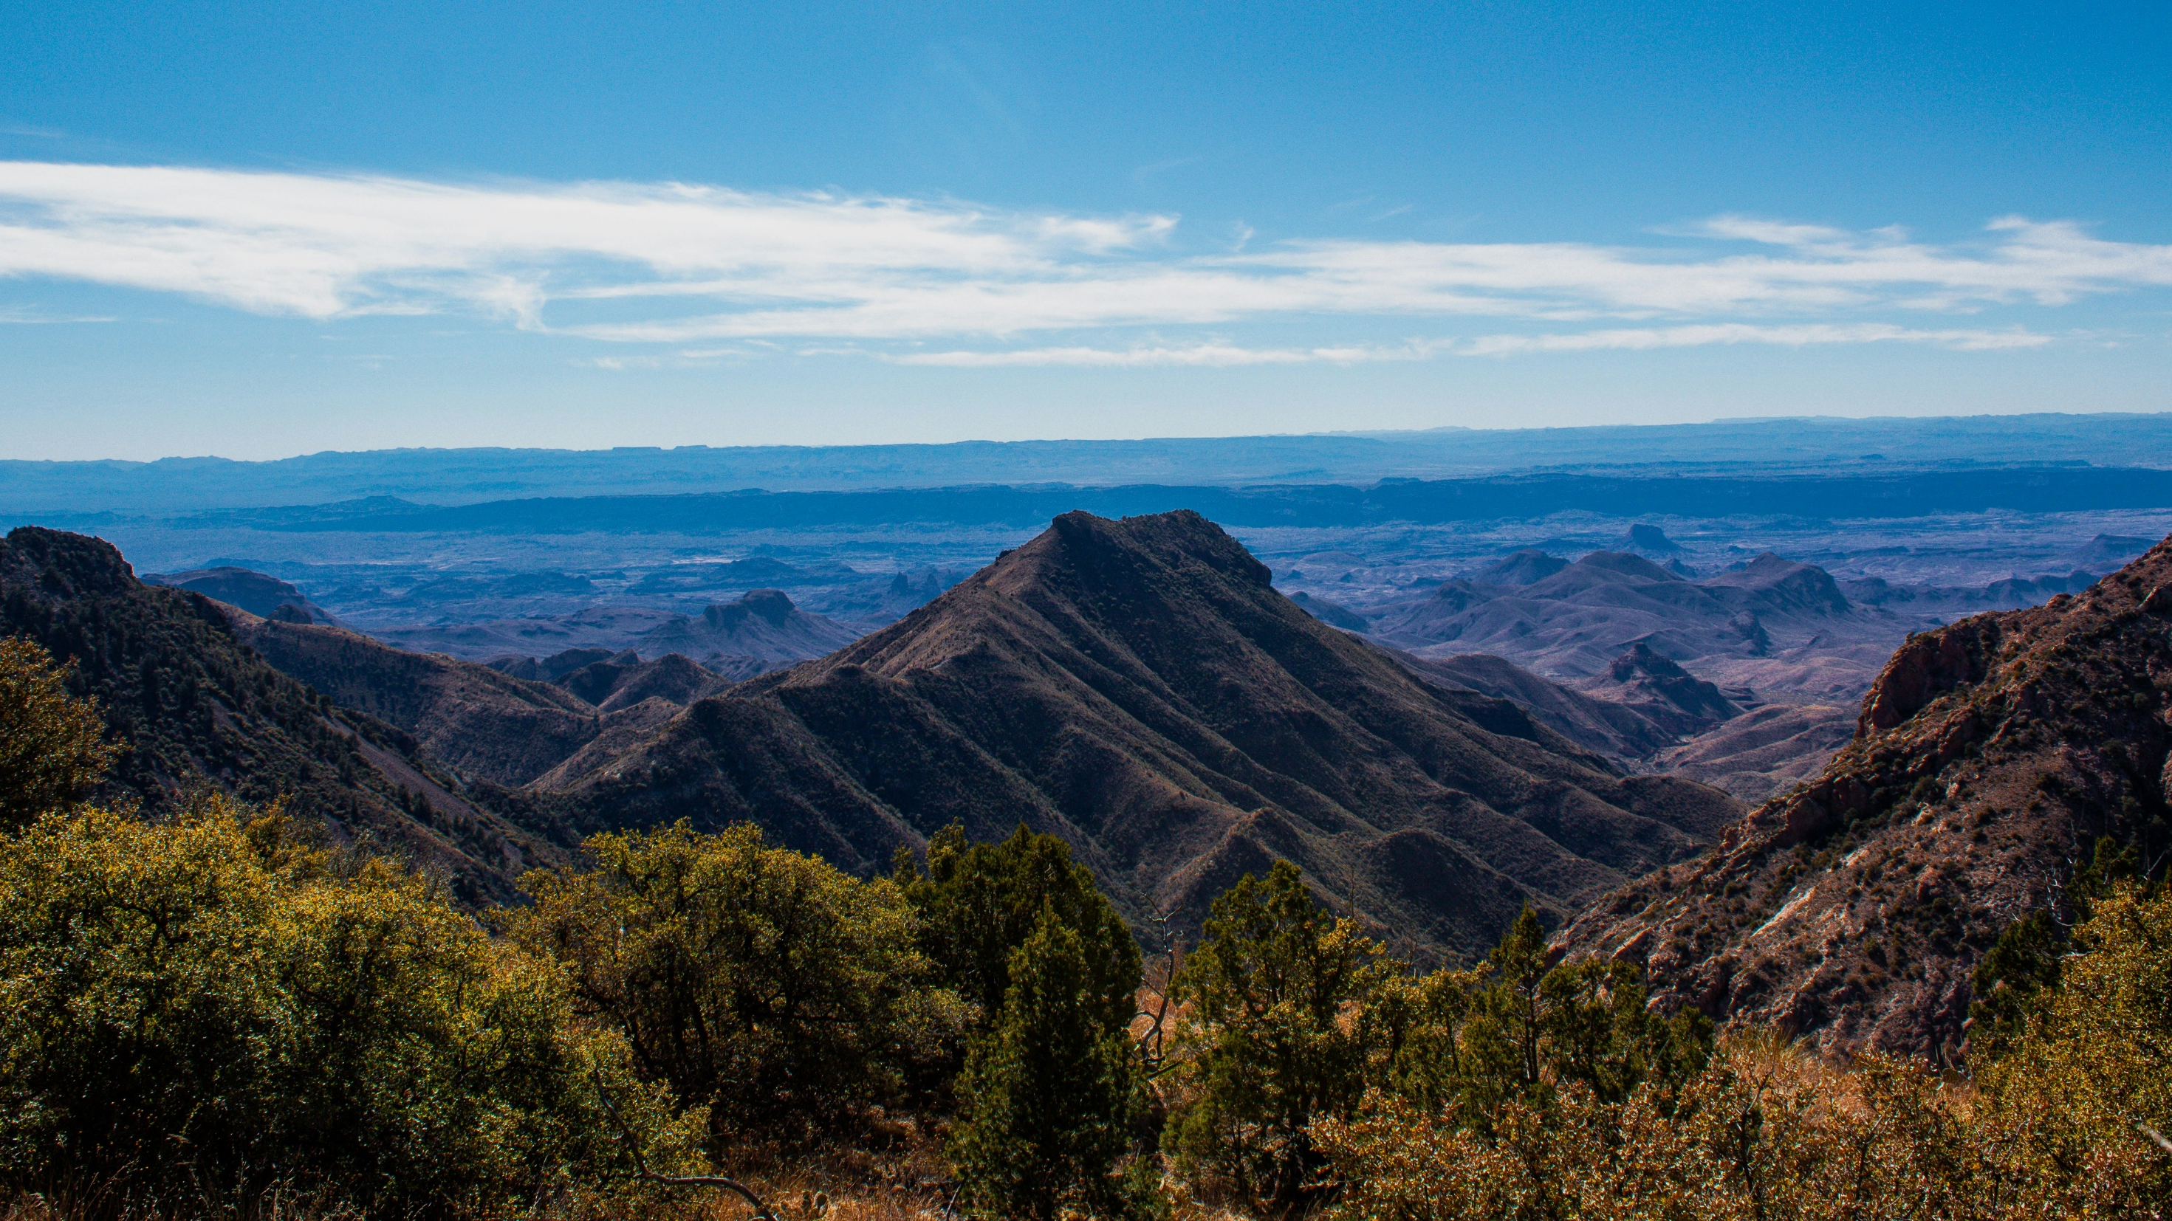





Project Overview
INTRODUCTION
Setting the project goals and introducing the data. Posing questions for analysis to answer.
CLEANING
Cleaning the data, deleting duplicates, and merging into one DataFrame.
CONCLUSION
Summarising findings and answers to the main questions.
2
4
1
3
EXPLORATION
Initialising the libraries and loading data into DataFrames. Exploring the unedited, raw DataFrames.
ANALYSIS
Beginning EDA (Exploratory Data Analysis). Analysing and visualising main points to answer questions.

Slide 3


Slide 5
INTRODUCTION

Slide 6
INTRODUCTION

Slide 7
INTRODUCTION

Slide 8
INTRODUCTION
This aim of this project was to analyse and explore the biodiversity of species across a selection of national parks. Through Exploratory Data Analysis (EDA) of the conservation statuses of the species, we investigated if there were any common themes to the types of species that become endangered. Two datasets used in this project were provided by the Codecademy website.
The primary goals were to clean, explore and analyse the data, before visualising the findings to try and answer the project questions posed in this introduction.

Slide 9
INTRODUCTION
This aim of this project was to analyse and explore the biodiversity of species across a selection of national parks. Through Exploratory Data Analysis (EDA) of the conservation statuses of the species, we investigated if there were any common themes to the types of species that become endangered. Two datasets used in this project were provided by the Codecademy website.
The primary goals were to clean, explore and analyse the data, before visualising the findings to try and answer the project questions posed in this introduction.
QUESTIONS:
What does the distribution of endangered species look like across the parks?
What proportion of the species in each category are endangered or have a conservation status?
Which category has the most endangered species, and are species in some categories more likely to be endangered?

Slide 10
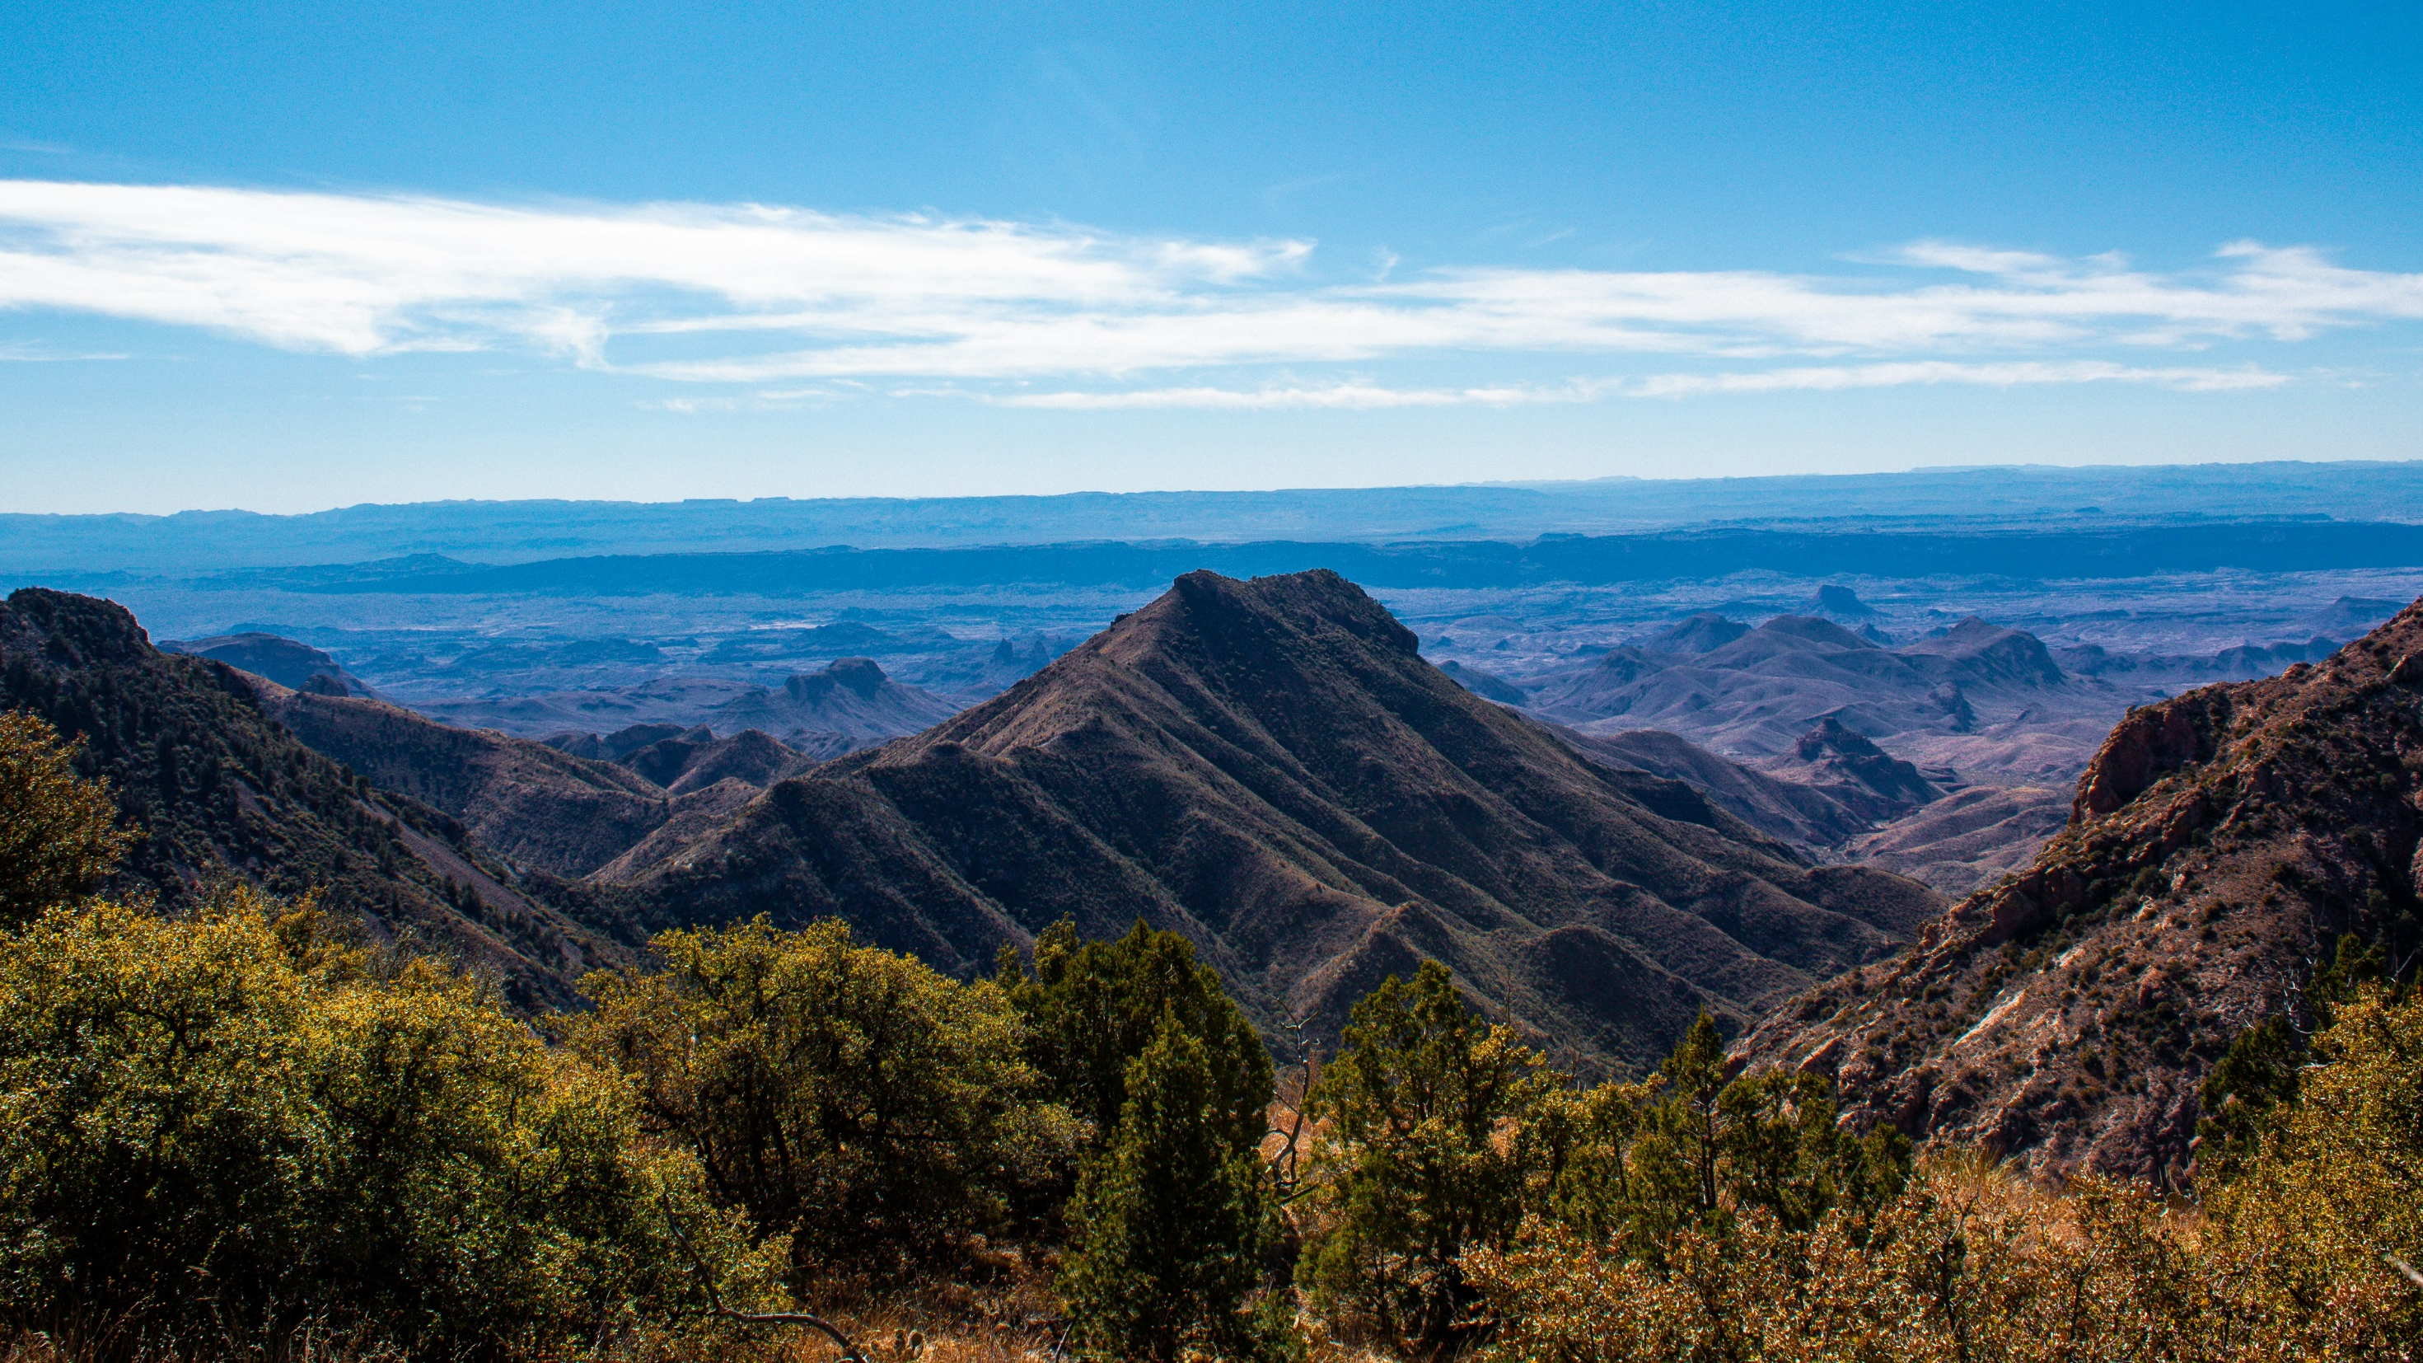
INTRODUCTION
This aim of this project was to analyse and explore the biodiversity of species across a selection of national parks. Through Exploratory Data Analysis (EDA) of the conservation statuses of the species, we investigated if there were any common themes to the types of species that become endangered. Two datasets used in this project were provided by the Codecademy website.
The primary goals were to clean, explore and analyse the data, before visualising the findings to try and answer the project questions posed in this introduction.
QUESTIONS:
What does the distribution of endangered species look like across the parks?
What proportion of the species in each category are endangered or have a conservation status?
Which category has the most endangered species, and are species in some categories more likely to be endangered?
Project Overview
INTRODUCTION
Setting the project goals and introducing the data. Posing questions for analysis to answer.
CLEANING
CONCLUSION
Cleaning the data, deleting duplicates, and merging into one DataFrame.
Summarising findings and answers to the main questions.
2
4
1
3
EXPLORATION
Initialising the libraries and loading data into DataFrames. Exploring the unedited, raw DataFrames.
ANALYSIS
Beginning EDA (Exploratory Data Analysis). Analysing and visualising main points to answer questions.
1

Slide 11
Project Overview
INTRODUCTION
Setting the project goals and introducing the data. Posing questions for analysis to answer.
CLEANING
Cleaning the data, deleting duplicates, and merging into one DataFrame.
CONCLUSION
Summarising findings and answers to the main questions.
2
4
1
3
EXPLORATION
Initialising the libraries and loading data into DataFrames. Exploring the unedited, raw DataFrames.
ANALYSIS
Beginning EDA (Exploratory Data Analysis). Analysing and visualising main points to answer questions.

Slide 12


Slide 14
EXPLORATION

Slide 15
EXPLORATION

Slide 16
EXPLORATION

Slide 17
EXPLORATION
The first step in the ‘exploration’ section was initialising the data and loading in the Python libraries required for the project. The following Python Libraries were used:
Pandas
Numpy
scipy.stats
Matplotlib
matplotlib.ticker
Seaborn

Slide 18
EXPLORATION
- OVERVIEW
The first step in the ‘exploration’ section was initialising the data and loading in the Python libraries required for the project. The following Python Libraries were used:
Pandas
Numpy
scipy.stats
Matplotlib
matplotlib.ticker
Seaborn

Slide 19
EXPLORATION
- OVERVIEW
The first step in the ‘exploration’ section was initialising the data and loading in the Python libraries required for the project. The following Python Libraries were used:
Pandas
Numpy
scipy.stats
Matplotlib
matplotlib.ticker
Seaborn

Slide 20
EXPLORATION
- OVERVIEW
The first step in the ‘exploration’ section was initialising the data and loading in the Python libraries required for the project. The following Python Libraries were used:
Pandas
Numpy
scipy.stats
Matplotlib
matplotlib.ticker
Seaborn
The second step was loading the two datasets into dataframes, before previewing the first five rows of each one.
The ’observations’ dataset contained information on the number of each species observed across the national parks, while the ’species_info’ dataset
contained the names and conservation statuses of the species.

Slide 21
EXPLORATION
- OVERVIEW
The first step in the ‘exploration’ section was initialising the data and loading in the Python libraries required for the project. The following Python Libraries were used:
Pandas
Numpy
scipy.stats
Matplotlib
matplotlib.ticker
Seaborn
The second step was loading the two datasets into dataframes, before previewing the first five rows of each one.
The ’observations’ dataset contained information on the number of each species observed across the national parks, while the ’species_info’ dataset
contained the names and conservation statuses of the species.

Slide 22
EXPLORATION
- OVERVIEW
The first step in the ‘exploration’ section was initialising the data and loading in the Python libraries required for the project. The following Python Libraries were used:
Pandas
Numpy
scipy.stats
Matplotlib
matplotlib.ticker
Seaborn
The second step was loading the two datasets into dataframes, before previewing the first five rows of each one.
The ’observations’ dataset contained information on the number of each species observed across the national parks, while the ’species_info’ dataset
contained the names and conservation statuses of the species.
After previewing some summary statistics, we found that ’observations’ had 23296 rows of data with no missing values. On the other hand, ’species_info’ had 5824 rows with many rows missing information on conservation status.

Slide 23
EXPLORATION
- OVERVIEW
The first step in the ‘exploration’ section was initialising the data and loading in the Python libraries required for the project. The following Python Libraries were used:
Pandas
Numpy
scipy.stats
Matplotlib
matplotlib.ticker
Seaborn
The second step was loading the two datasets into dataframes, before previewing the first five rows of each one.
The ’observations’ dataset contained information on the number of each species observed across the national parks, while the ’species_info’ dataset
contained the names and conservation statuses of the species.
After previewing some summary statistics, we found that ’observations’ had 23296 rows of data with no missing values. On the other hand, ’species_info’ had 5824 rows with many rows missing information on conservation status.

Slide 24
EXPLORATION
- OVERVIEW
The first step in the ‘exploration’ section was initialising the data and loading in the Python libraries required for the project. The following Python Libraries were used:
Pandas
Numpy
scipy.stats
Matplotlib
matplotlib.ticker
Seaborn
The second step was loading the two datasets into dataframes, before previewing the first five rows of each one.
The ’observations’ dataset contained information on the number of each species observed across the national parks, while the ’species_info’ dataset
contained the names and conservation statuses of the species.
After previewing some summary statistics, we found that ’observations’ had 23296 rows of data with no missing values. On the other hand, ’species_info’ had 5824 rows with many rows missing information on conservation status.

Slide 25
EXPLORATION
- OVERVIEW
The first step in the ‘exploration’ section was initialising the data and loading in the Python libraries required for the project. The following Python Libraries were used:
Pandas
Numpy
scipy.stats
Matplotlib
matplotlib.ticker
Seaborn
The second step was loading the two datasets into dataframes, before previewing the first five rows of each one.
The ’observations’ dataset contained information on the number of each species observed across the national parks, while the ’species_info’ dataset
contained the names and conservation statuses of the species.

Slide 26
EXPLORATION
- OVERVIEW
The first step in the ‘exploration’ section was initialising the data and loading in the Python libraries required for the project. The following Python Libraries were used:
Pandas
Numpy
scipy.stats
Matplotlib
matplotlib.ticker
Seaborn
The second step was loading the two datasets into dataframes, before previewing the first five rows of each one.
The ’observations’ dataset contained information on the number of each species observed across the national parks, while the ’species_info’ dataset
contained the names and conservation statuses of the species.

Slide 27
EXPLORATION
- OVERVIEW

Slide 28
EXPLORATION
- OVERVIEW
- COLUMNS

Slide 29
EXPLORATION
- OVERVIEW
- COLUMNS

Slide 30
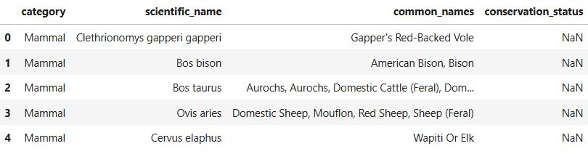
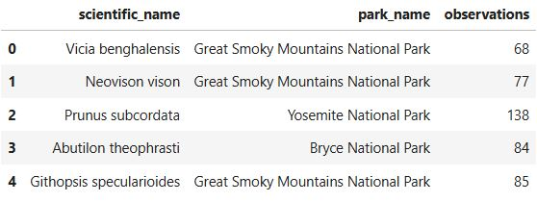
EXPLORATION
- COLUMNS
category: the classification of the species by category
scientific_name: the scientific or latin name for each species
common_names: common names for each species
conservation_status: the conservation status of the species
scientific_name: the scientific names of each species
park_name: the name of the national park where the observations were made
observations: the number of observations of the species made over the past week
species_info
observations
After previewing the data, we began to look at the columns in the datasets.
Some information on each column is displayed above.

Slide 31
EXPLORATION
- COLUMNS
category: the classification of the species by category
scientific_name: the scientific or latin name for each species
common_names: common names for each species
conservation_status: the conservation status of the species
scientific_name: the scientific names of each species
park_name: the name of the national park where the observations were made
observations: the number of observations of the species made over the past week
species_info
observations
After previewing the data, we began to look at the columns in the datasets.
Some information on each column is displayed above.

Slide 32
EXPLORATION
- COLUMNS
category: the classification of the species by category
scientific_name: the scientific or latin name for each species
common_names: common names for each species
conservation_status: the conservation status of the species
scientific_name: the scientific names of each species
park_name: the name of the national park where the observations were made
observations: the number of observations of the species made over the past week
species_info
observations
After examining each column in the two dataframes, we took a closer look at some of the columns and discovered some key information.
After previewing the data, we began to look at the columns in the datasets.
Some information on each column is displayed above.

Slide 33
EXPLORATION
- COLUMNS
category: the classification of the species by category
scientific_name: the scientific or latin name for each species
common_names: common names for each species
conservation_status: the conservation status of the species
scientific_name: the scientific names of each species
park_name: the name of the national park where the observations were made
observations: the number of observations of the species made over the past week
species_info
observations
After examining each column in the two dataframes, we took a closer look at some of the columns and discovered some key information.
There were multiple duplicate rows in the ’species_info’ dataset. In addition, the ’conservation_status’ column had many empty ’NaN’ values that coincided with species not currently under threat.
The four unique statuses were:
‘Endangered’
‘Threatened’
‘Species of Concern’
‘In Recovery’
In ’observations’, the ’park_name’ column had four unique national parks. These were:
‘Great Smoky Mountains National Park’
‘Yosemite National Park’
‘Bryce National Park’
‘Yellowstone National Park’
The ’observations’dataset did not appear to have any missing or duplicate data.

Slide 34
EXPLORATION
- COLUMNS
category: the classification of the species by category
scientific_name: the scientific or latin name for each species
common_names: common names for each species
conservation_status: the conservation status of the species
scientific_name: the scientific names of each species
park_name: the name of the national park where the observations were made
observations: the number of observations of the species made over the past week
species_info
observations
There were multiple duplicate rows in the ’species_info’ dataset. In addition, the ’conservation_status’ column had many empty ’NaN’ values that coincided with species not currently under threat.
The four unique statuses were:
‘Endangered’
‘Threatened’
‘Species of Concern’
‘In Recovery’
In ’observations’, the ’park_name’ column had four unique national parks. These were:
‘Great Smoky Mountains National Park’
‘Yosemite National Park’
‘Bryce National Park’
‘Yellowstone National Park’
The ’observations’dataset did not appear to have any missing or duplicate data.
After examining each column in the two dataframes, we took a closer look at some of the columns and discovered some key information.

Slide 35
Project Overview
INTRODUCTION
Setting the project goals and introducing the data. Posing questions for analysis to answer.
CLEANING
Cleaning the data, deleting duplicates, and merging into one DataFrame.
CONCLUSION
Summarising findings and answers to the main questions.
2
4
1
3
EXPLORATION
Initialising the libraries and loading data into DataFrames. Exploring the unedited, raw DataFrames.
ANALYSIS
Beginning EDA (Exploratory Data Analysis). Analysing and visualising main points to answer questions.

Slide 36


Slide 38
CLEANING

Slide 39
CLEANING

Slide 40
CLEANING

Slide 41
CLEANING
+ MERGING
As the ‘exploration’ section uncovered, some of the columns in the data had missing or duplicate values. Those columns were cleaned and updated so we could merge the dataframes cleanly.

Slide 42
CLEANING
+ MERGING
As the ‘exploration’ section uncovered, some of the columns in the data had missing or duplicate values. Those columns were cleaned and updated so we could merge the dataframes cleanly.

Slide 43
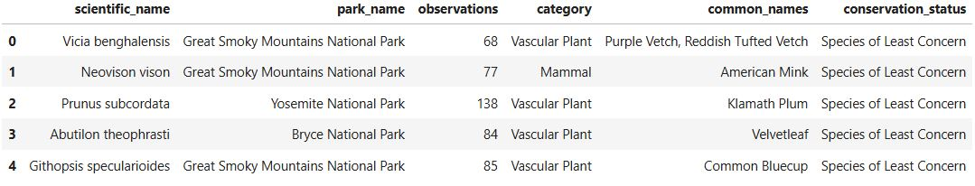


CLEANING
+ MERGING
The ‘scientific_name’ column in the ’species_info’ dataframe had duplicate values, and the ’conservation_status’ column had many missing values. This is how we cleaned them.
For the ’scientific_name’ column, we dropped the duplicate rows and kept only the most recent information, as it would be relevant to the later analysis.
For the ’conservation_status’ column, the missing values represented the species that were not endangered. Therefore, the NaN values could be replaced with a suitable label, in this case 'Species of Least Concern'.
With the columns cleaned, the two dataframes could now be merged into one to make analysis more efficient. An inner merge was used to combine ’species_info’ and ’observations’ into one dataframe, ’species_obsv’.
A preview of the merged dataframe is displayed below.
As the ‘exploration’ section uncovered, some of the columns in the data had missing or duplicate values. Those columns were cleaned and updated so we could merge the dataframes cleanly.

Slide 44
CLEANING
+ MERGING
The ‘scientific_name’ column in the ’species_info’ dataframe had duplicate values, and the ’conservation_status’ column had many missing values. This is how we cleaned them.
For the ’scientific_name’ column, we dropped the duplicate rows and kept only the most recent information, as it would be relevant to the later analysis.
For the ’conservation_status’ column, the missing values represented the species that were not endangered. Therefore, the NaN values could be replaced with a suitable label, in this case 'Species of Least Concern'.
With the columns cleaned, the two dataframes could now be merged into one to make analysis more efficient. An inner merge was used to combine ’species_info’ and ’observations’ into one dataframe, ’species_obsv’.
A preview of the merged dataframe is displayed below.

Slide 45
Project Overview
INTRODUCTION
Setting the project goals and introducing the data. Posing questions for analysis to answer.
CLEANING
Cleaning the data, deleting duplicates, and merging into one DataFrame.
CONCLUSION
Summarising findings and answers to the main questions.
2
4
1
3
EXPLORATION
Initialising the libraries and loading data into DataFrames. Exploring the unedited, raw DataFrames.
ANALYSIS
Beginning EDA (Exploratory Data Analysis). Analysing and visualising main points to answer questions.

Slide 46


Slide 48
ANALYSIS

Slide 49
ANALYSIS

Slide 50
ANALYSIS

Slide 51



ANALYSIS
Continuing to the third part of the project, we began the analysis of the cleaned and merged data to try and answer the questions posed in the introduction. As a reminder, the questions are as follows:

Slide 52
ANALYSIS
Continuing to the third part of the project, we began the analysis of the cleaned and merged data to try and answer the questions posed in the introduction. As a reminder, the questions are as follows:

Slide 53

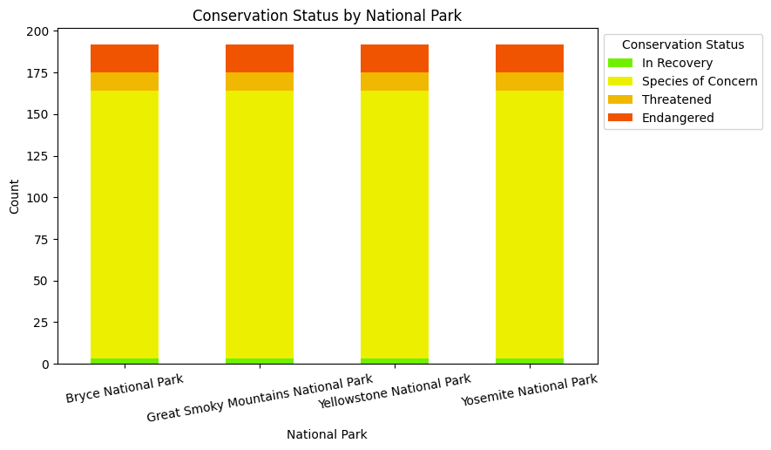
What does the distribution of endangered species look like across the parks?
SECTION 1:
CONSERVATION STATUS BY NATIONAL PARK

Slide 54
What does the distribution of endangered species look like across the parks?
SECTION 1:
CONSERVATION STATUS BY NATIONAL PARK
We began by visualising the conservation status of species across the four national parks.
The distribution of species in each conservation status category was equal. We determined that this was due to all the species being present in each park.

Slide 55
SECTION 1:
CONSERVATION STATUS BY NATIONAL PARK
We began by visualising the conservation status of species across the four national parks.
The distribution of species in each conservation status category was equal. We determined that this was due to all the species being present in each park.
Since this did not tell us much about the proportion of species in each conservation category across the parks, we created another graph.

Slide 56
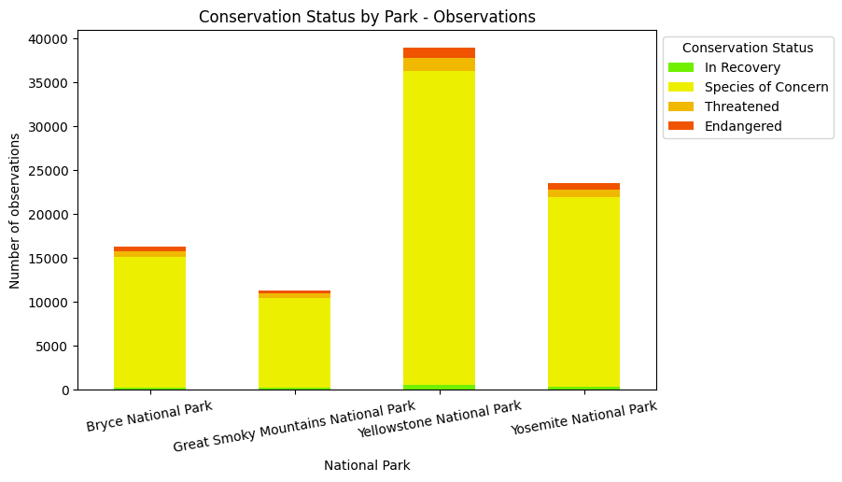
SECTION 1:
CONSERVATION STATUS BY NATIONAL PARK
We began by visualising the conservation status of species across the four national parks.
The distribution of species in each conservation status category was equal. We determined that this was due to all the species being present in each park.
Since this did not tell us much about the proportion of species in each conservation category across the parks, we created another graph.
The second graph visualised the observations of species in each conservation status category, grouping them by national park. This graph was more informative, and from it we were able to see that ‘Yellowstone National Park’ had the most observations of ‘Endangered’ species, and the most observations overall. ‘Great Smoky Mountains National Park’ had the least observations overall in each category.
To investigate this further, we did some external research.

Slide 57
SECTION 1:
CONSERVATION STATUS BY NATIONAL PARK
Since this did not tell us much about the proportion of species in each conservation category across the parks, we created another graph.
We began by visualising the conservation status of species across the four national parks.
The distribution of species in each conservation status category was equal. We determined that this was due to all the species being present in each park.
The second graph visualised the number of observations of endangered species in each national park.
With it, we were able to see that ‘Yellowstone National Park’ had the most observations overall in each conservation status.
‘Great Smoky Mountains National Park’ had the least observations overall in each conservation status.
To investigate this further, we did some external research.

Slide 58
SECTION 1:
CONSERVATION STATUS BY NATIONAL PARK
Since this did not tell us much about the proportion of species in each conservation category across the parks, we created another graph.
The second graph visualised the number of observations of endangered species in each national park.
With it, we were able to see that ‘Yellowstone National Park’ had the most observations overall in each conservation status.
‘Great Smoky Mountains National Park’ had the least observations overall in each conservation status.
To investigate this further, we did some external research.

Slide 59
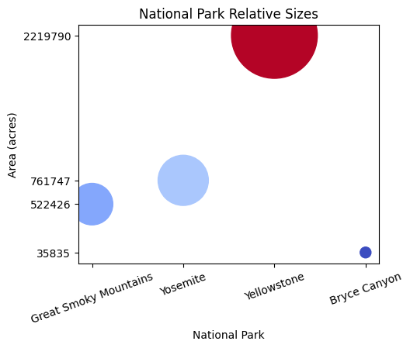
SECTION 1:
CONSERVATION STATUS BY NATIONAL PARK
To investigate this further, we did some external research.
Since this did not tell us much about the proportion of species in each conservation category across the parks, we created another graph.
The second graph visualised the number of observations of endangered species in each national park.
With it, we were able to see that ‘Yellowstone National Park’ had the most observations overall in each conservation status.
‘Great Smoky Mountains National Park’ had the least observations overall in each conservation status.
We found that Yellowstone National Park is the biggest national park out of the four, with an average area of 2,219,790 acres, allowing it to accommodate a more numerous population of each species.
The relative sizes of the parks are shown in the figure to the right.
(source: https://morethanjustparks.com/us-national-parks-by-size/)

Slide 60
SECTION 1:
CONSERVATION STATUS BY NATIONAL PARK
To investigate this further, we did some external research.
We found that Yellowstone National Park is the biggest national park out of the four, with an average area of 2,219,790 acres, allowing it to accommodate a more numerous population of each species.
The relative sizes of the parks are shown in the figure to the right.
(source: https://morethanjustparks.com/us-national-parks-by-size/)
SECTION 2:
DISTRIBUTION OF SPECIES
We found that Yellowstone National Park is the biggest national park out of the four, with an average area of 2,219,790 acres, allowing it to accommodate a more numerous population of each species.
The relative sizes of the parks are shown in the figure to the right.
(source: https://morethanjustparks.com/us-national-parks-by-size/)

Slide 61
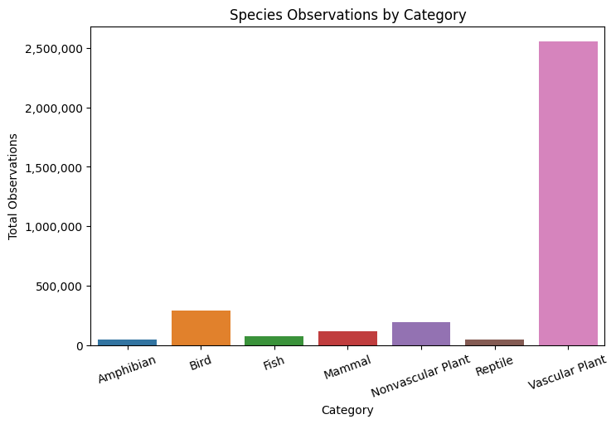
SECTION 1:
CONSERVATION STATUS BY NATIONAL PARK
To investigate this further, we did some external research.
We found that Yellowstone National Park is the biggest national park out of the four, with an average area of 2,219,790 acres, allowing it to accommodate a more numerous population of each species.
The relative sizes of the parks are shown in the figure to the right.
(source: https://morethanjustparks.com/us-national-parks-by-size/)
SECTION 2:
DISTRIBUTION OF SPECIES
To understand the data better, we analysed the distribution of species by ‘Category’.
We found that Yellowstone National Park is the biggest national park out of the four, with an average area of 2,219,790 acres, allowing it to accommodate a more numerous population of each species.
The relative sizes of the parks are shown in the figure to the right.
(source: https://morethanjustparks.com/us-national-parks-by-size/)

Slide 62
SECTION 2:
DISTRIBUTION OF SPECIES
To understand the data better, we analysed the distribution of species by ‘Category’.
The ‘Vascular Plant’ category had by far the most observations of species, followed by ‘Bird’.
The ‘Reptile’ and ‘Amphibian’ categories had the least observations of species in the complete dataframe.

Slide 63
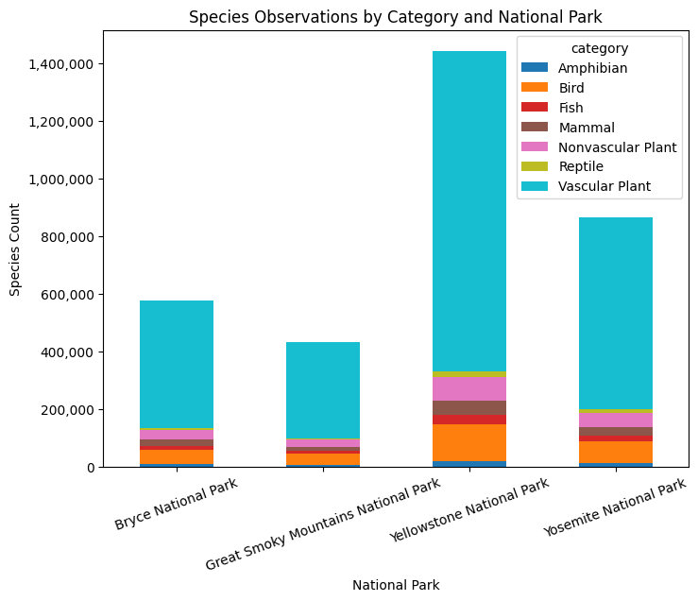
SECTION 2:
DISTRIBUTION OF SPECIES
To understand the data better, we analysed the distribution of species by ‘Category’.
The distribution of species of each category in each national park is displayed to the left. ‘Yellowstone National Park’ had the highest count of observations of species in each category.
The ‘Vascular Plant’ category has the most observations in all the parks, and the ‘Reptile’ category has the least.
The ‘Vascular Plant’ category had by far the most observations of species, followed by ‘Bird’.
The ‘Reptile’ and ‘Amphibian’ categories had the least observations of species in the complete dataframe.

Slide 64
SECTION 2:
DISTRIBUTION OF SPECIES
To understand the data better, we analysed the distribution of species by ‘Category’.
The distribution of species of each category in each national park is displayed to the left. ‘Yellowstone National Park’ had the highest count of observations of species in each category.
The ‘Vascular Plant’ category has the most observations in all the parks, and the ‘Reptile’ category has the least.
The ‘Vascular Plant’ category had by far the most observations of species, followed by ‘Bird’.
The ‘Reptile’ and ‘Amphibian’ categories had the least observations of species in the complete dataframe.

Slide 65

What proportion of the species in each category are endangered or have a conservation status?
SECTION 3:
CONSERVATION STATUS BY SPECIES CATEGORY

Slide 66
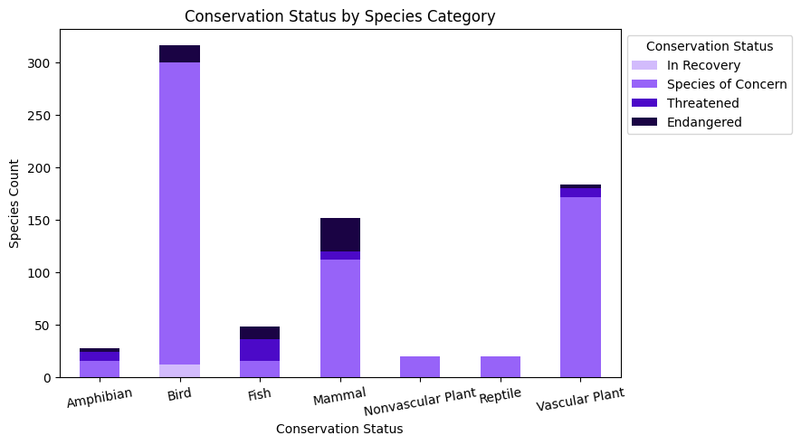
What proportion of the species in each category are endangered or have a conservation status?
SECTION 3:
CONSERVATION STATUS BY SPECIES CATEGORY

Slide 67
SECTION 3:
CONSERVATION STATUS BY SPECIES CATEGORY

Slide 68
SECTION 3:
CONSERVATION STATUS BY SPECIES CATEGORY
The chart to the left visualises the proportion of species of each conservation status in each category.
The ‘Nonvascular Plant’ and ‘Reptile’ categories do not appear to have any ‘Endangered’ species.
The ‘Bird’ category is the only category with species ‘In Recovery’.
The ’Mammal’ category has the most ‘Endangered’ species out of all the categories and appears to be under the most threat.

Slide 69
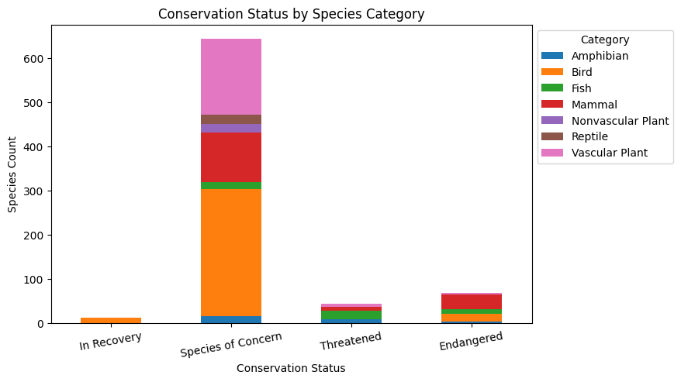
SECTION 3:
CONSERVATION STATUS BY SPECIES CATEGORY
The chart to the left visualises the proportion of species of each conservation status in each category.
The ‘Nonvascular Plant’ and ‘Reptile’ categories do not appear to have any ‘Endangered’ species.
The ‘Bird’ category is the only category with species ‘In Recovery’.
The ’Mammal’ category has the most ‘Endangered’ species out of all the categories and appears to be under the most threat.

Slide 70
SECTION 3:
CONSERVATION STATUS BY SPECIES CATEGORY
By changing the columns of the bar chart, we were able to look at the categories’ conservation statuses from a different angle.
From the chart above, it is clear that ‘Species of Concern’ has the most categories, with ‘Bird’ being the largest.
‘Fish’ is the most ‘Threatened’ category, and ‘Mammal’ remains the most ‘Endangered’ category in the bar chart.

Slide 71
SECTION 3:
CONSERVATION STATUS BY SPECIES CATEGORY
By changing the columns of the bar chart, we were able to look at the categories’ conservation statuses from a different angle.
From the chart above, it is clear that ‘Species of Concern’ has the most categories, with ‘Bird’ being the largest.
‘Fish’ is the most ‘Threatened’ category, and ‘Mammal’ remains the most ‘Endangered’ category in the bar chart.

Slide 72
SECTION 3:
CONSERVATION STATUS BY SPECIES CATEGORY
By changing the columns of the bar chart, we were able to look at the categories’ conservation statuses from a different angle.
From the chart above, it is clear that ‘Species of Concern’ has the most categories, with ‘Bird’ being the largest.
‘Fish’ is the most ‘Threatened’ category, and ‘Mammal’ remains the most ‘Endangered’ category in the bar chart.

Slide 73
SECTION 3:
CONSERVATION STATUS BY SPECIES CATEGORY
By changing the columns of the bar chart, we were able to look at the categories’ conservation statuses from a different angle.
From the chart above, it is clear that ‘Species of Concern’ has the most categories, with ‘Bird’ being the largest.
‘Fish’ is the most ‘Threatened’ category, and ‘Mammal’ remains the most ‘Endangered’ category in the bar chart.

Slide 74
SECTION 3:
CONSERVATION STATUS BY SPECIES CATEGORY
By changing the columns of the bar chart, we were able to look at the categories’ conservation statuses from a different angle.
From the chart above, it is clear that ‘Species of Concern’ has the most categories, with ‘Bird’ being the largest.
‘Fish’ is the most ‘Threatened’ category, and ‘Mammal’ remains the most ‘Endangered’ category in the bar chart.

Slide 75
SECTION 3:
CONSERVATION STATUS BY SPECIES CATEGORY
Since ‘Endangered’ species were the primary focus of this project, we investigated the species in the ‘Endangered’ column in more depth, analysing each category in turn. We focused on the largest category, ‘Mammals’, before looking at the rest in order of which category had more ‘Endangered’ species.

Slide 76
SECTION 3:
CONSERVATION STATUS BY SPECIES CATEGORY
Since ‘Endangered’ species were the primary focus of this project, we investigated the species in the ‘Endangered’ column in more depth, analysing each category in turn. We focused on the largest category, ‘Mammals’, before looking at the rest in order of which category had more ‘Endangered’ species.
SECTION 4:
OBSERVATIONS OF ENDANGERED SPECIES

Slide 77
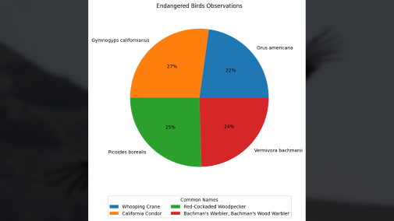
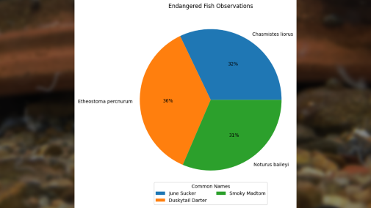
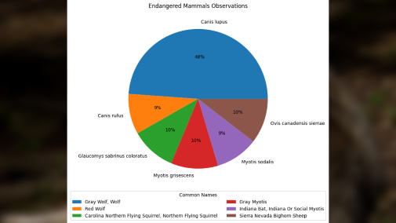

SECTION 3:
CONSERVATION STATUS BY SPECIES CATEGORY
Since ‘Endangered’ species were the primary focus of this project, we investigated the species in the ‘Endangered’ column in more depth, analysing each category in turn. We focused on the largest category, ‘Mammals’, before looking at the rest in order of which category had more ‘Endangered’ species.
SECTION 4:
OBSERVATIONS OF ENDANGERED SPECIES
BIRDS
MAMMALS
FISH

Slide 78
SECTION 3:
CONSERVATION STATUS BY SPECIES CATEGORY
SECTION 4:
OBSERVATIONS OF ENDANGERED SPECIES
BIRDS
MAMMALS
FISH

Slide 79

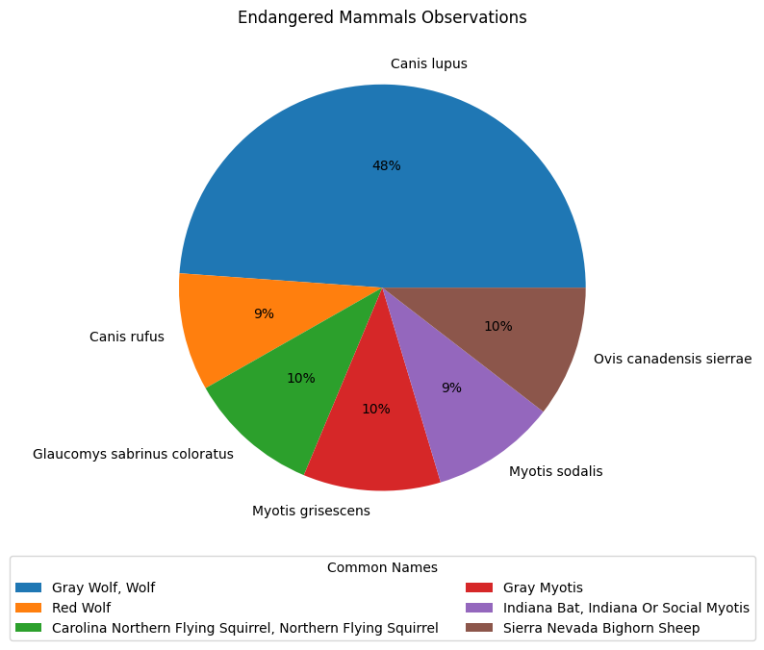
SECTION 4:
OBSERVATIONS OF ENDANGERED SPECIES: MAMMALS

Slide 80
SECTION 4:
OBSERVATIONS OF ENDANGERED SPECIES: MAMMALS
The pie chart shows that the ‘Canis Lupus’, or the Gray Wolf, makes up almost 50% of the ‘Endangered’ species observed in the ‘Mammal’ category.
Another wolf, the Red Wolf, makes up 9%, while the other four species consist of a flying squirrel, a sheep, and two different bat species.

Slide 81
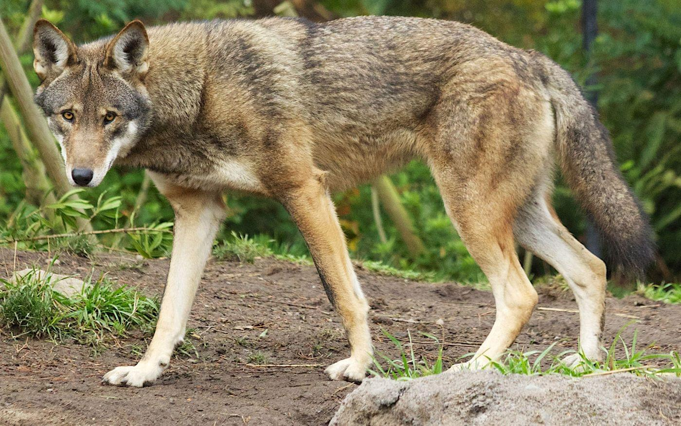
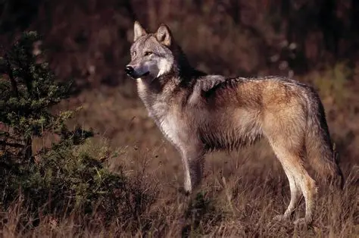
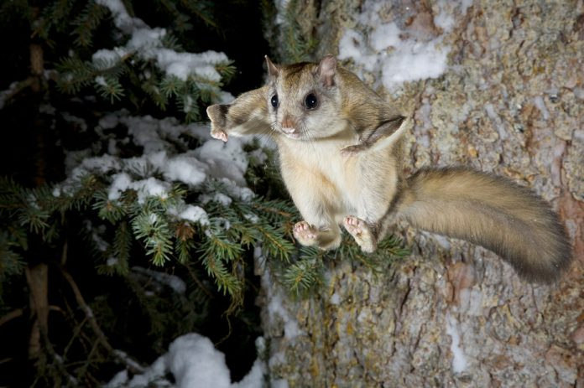
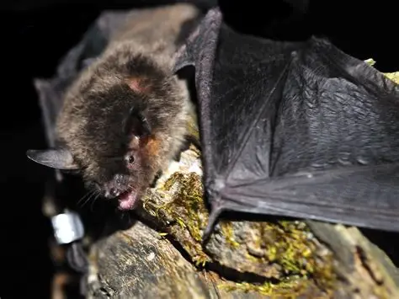
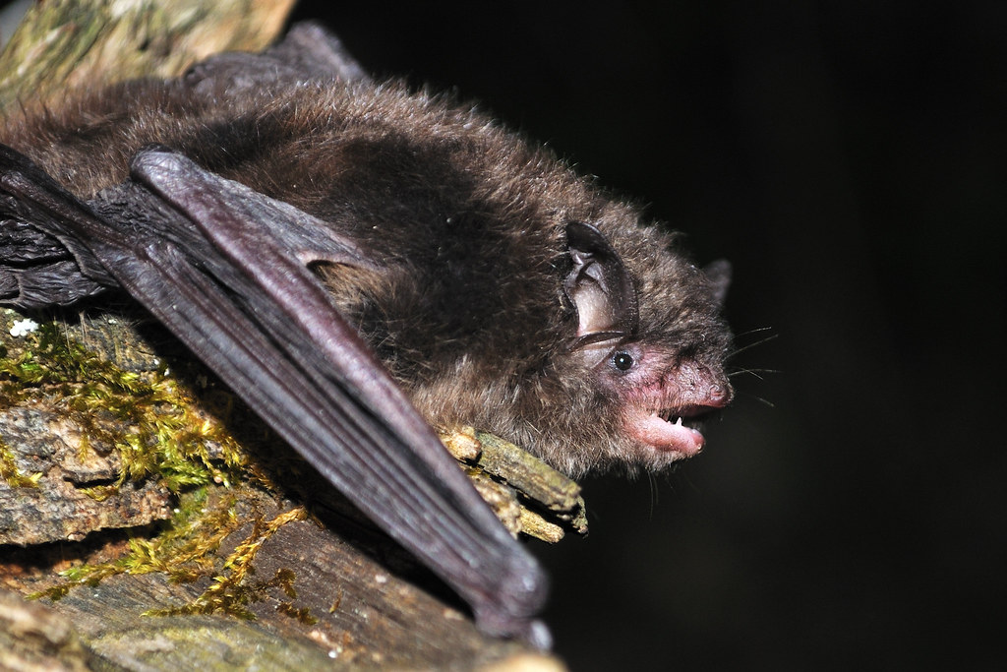
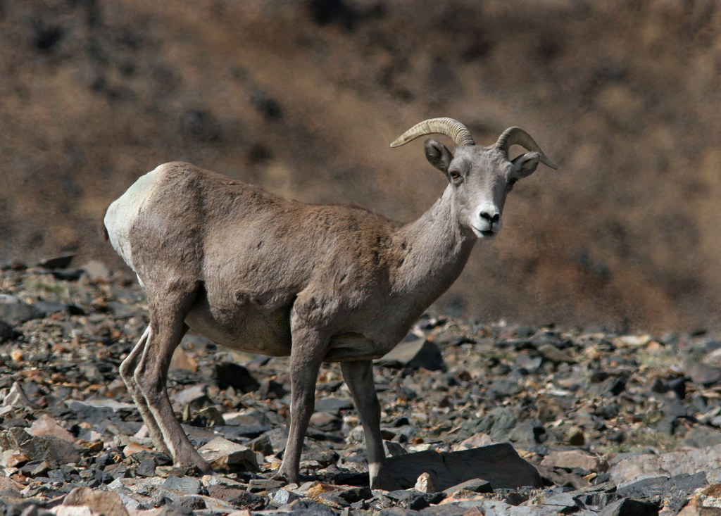
SECTION 4:
OBSERVATIONS OF ENDANGERED SPECIES: MAMMALS
The pie chart shows that the ‘Canis Lupus’, or the Gray Wolf, makes up almost 50% of the ‘Endangered’ species observed in the ‘Mammal’ category.
Another wolf, the Red Wolf, makes up 9%, while the other four species consist of a flying squirrel, a sheep, and two different bat species.
Canis lupus
Canis rufus
Glaucomys sabrinus coloratus
Myotis grisescens
Myotis sodalist
Ovis canadensis sierrae

Slide 82
SECTION 4:
OBSERVATIONS OF ENDANGERED SPECIES: MAMMALS
The pie chart shows that the ‘Canis Lupus’, or the Gray Wolf, makes up almost 50% of the ‘Endangered’ species observed in the ‘Mammal’ category.
Another wolf, the Red Wolf, makes up 9%, while the other four species consist of a flying squirrel, a sheep, and two different bat species.
Canis lupus
Canis rufus
Glaucomys sabrinus coloratus
Myotis grisescens
Myotis sodalist
Ovis canadensis sierrae

Slide 83
Canis lupus
SECTION 4:
OBSERVATIONS OF ENDANGERED SPECIES: MAMMALS
Canis rufus
Glaucomys sabrinus coloratus
Myotis grisescens
Myotis sodalist
Ovis canadensis sierrae

Slide 84
Canis lupus
Canis rufus
SECTION 4:
OBSERVATIONS OF ENDANGERED SPECIES: MAMMALS
Glaucomys sabrinus coloratus
Myotis grisescens
Myotis sodalist
Ovis canadensis sierrae

Slide 85
Canis lupus
Canis rufus
Glaucomys sabrinus coloratus
SECTION 4:
OBSERVATIONS OF ENDANGERED SPECIES: MAMMALS
Myotis grisescens
Myotis sodalist
Ovis canadensis sierrae

Slide 86
Canis lupus
Canis rufus
Glaucomys sabrinus coloratus
Myotis grisescens
SECTION 4:
OBSERVATIONS OF ENDANGERED SPECIES: MAMMALS
Myotis sodalist
Ovis canadensis sierrae

Slide 87
Canis lupus
Canis rufus
Glaucomys sabrinus coloratus
Myotis grisescens
Myotis sodalist
SECTION 4:
OBSERVATIONS OF ENDANGERED SPECIES: MAMMALS
Ovis canadensis sierrae

Slide 88

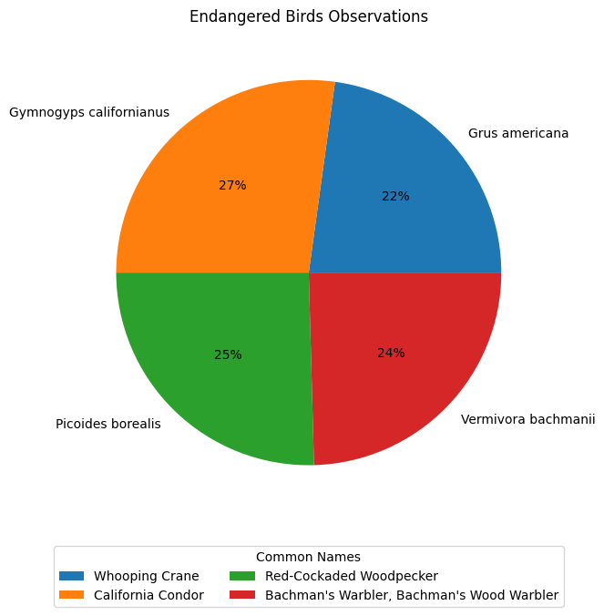
SECTION 5:
OBSERVATIONS OF ENDANGERED SPECIES: BIRDS

Slide 89
SECTION 5:
OBSERVATIONS OF ENDANGERED SPECIES: BIRDS
The proportion of each ‘Endangered’ species in the ‘Bird’ category is balanced.
The ‘Gymnogyps Californianus’, or the Californian Condor, has the most observations in the category at 27%.
The ‘Grus Americana’, or Whooping Crane, has the least, making up only 22% of the observations of endangered ‘Bird’ species.
Note: At the time of this project, the ‘Vermivora Bachmanii’ had been declared extinct.

Slide 90
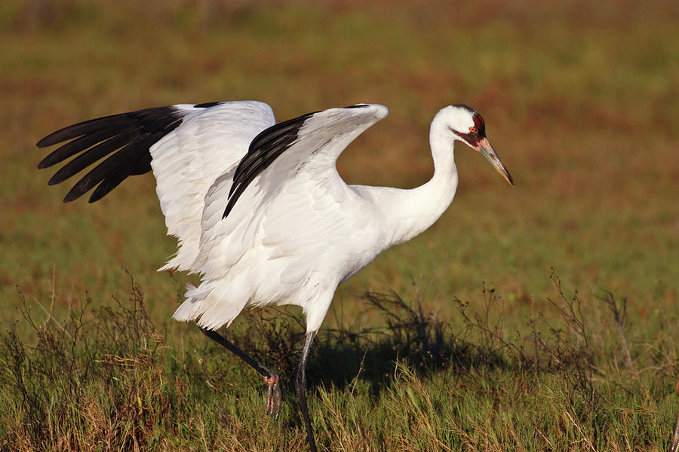
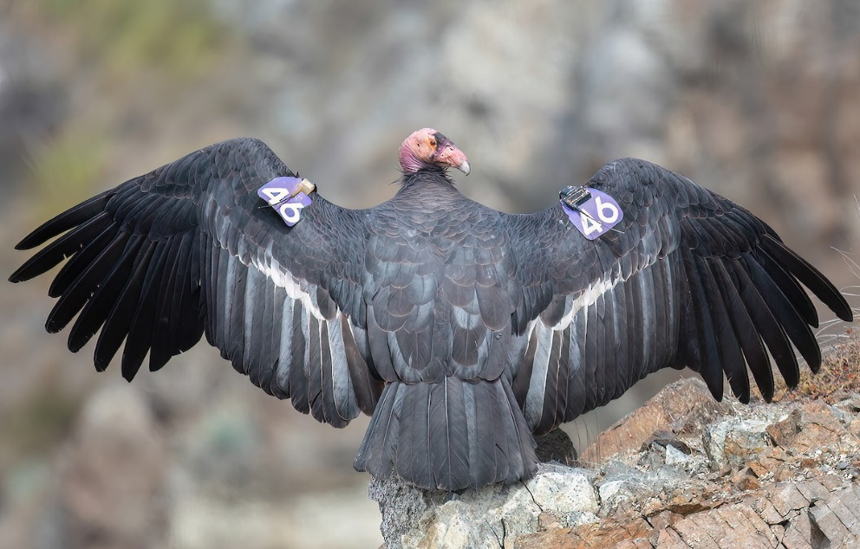
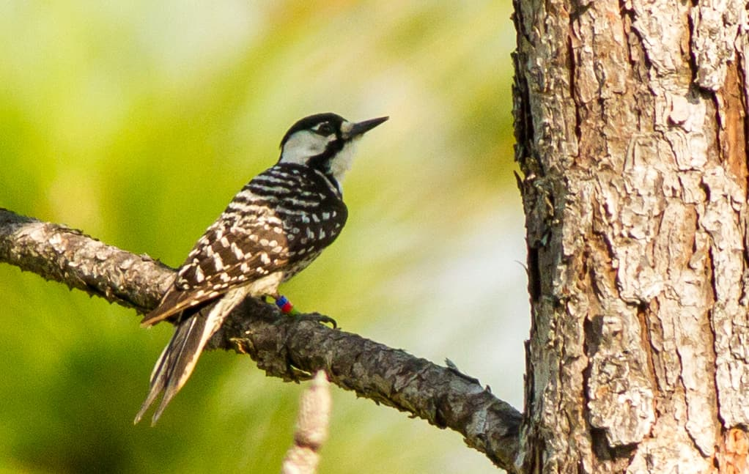
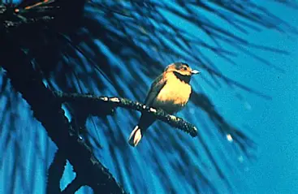
SECTION 5:
OBSERVATIONS OF ENDANGERED SPECIES: BIRDS
The proportion of each ‘Endangered’ species in the ‘Bird’ category is balanced.
The ‘Gymnogyps Californianus’, or the Californian Condor, has the most observations in the category at 27%.
The ‘Grus Americana’, or Whooping Crane, has the least, making up only 22% of the observations of endangered ‘Bird’ species.
Note: At the time of this project, the ‘Vermivora Bachmanii’ had been declared extinct.
Grus Americana
Gymnogyps Californianus
Picoides Borealis
Vermivora Bachmanii

Slide 91
SECTION 5:
OBSERVATIONS OF ENDANGERED SPECIES: BIRDS
The proportion of each ‘Endangered’ species in the ‘Bird’ category is balanced.
The ‘Gymnogyps Californianus’, or the Californian Condor, has the most observations in the category at 27%.
The ‘Grus Americana’, or Whooping Crane, has the least, making up only 22% of the observations of endangered ‘Bird’ species.
Grus Americana
Note: At the time of this project, the ‘Vermivora Bachmanii’ had been declared extinct.
Gymnogyps Californianus
Picoides Borealis
Vermivora Bachmanii

Slide 92
Grus Americana
SECTION 5:
OBSERVATIONS OF ENDANGERED SPECIES: BIRDS
Gymnogyps Californianus
Picoides Borealis
Vermivora Bachmanii

Slide 93
Grus Americana
Gymnogyps Californianus
SECTION 5:
OBSERVATIONS OF ENDANGERED SPECIES: BIRDS
Picoides Borealis
Vermivora Bachmanii

Slide 94
Grus Americana
Gymnogyps Californianus
Picoides Borealis
SECTION 5:
OBSERVATIONS OF ENDANGERED SPECIES: BIRDS
Vermivora Bachmanii

Slide 95
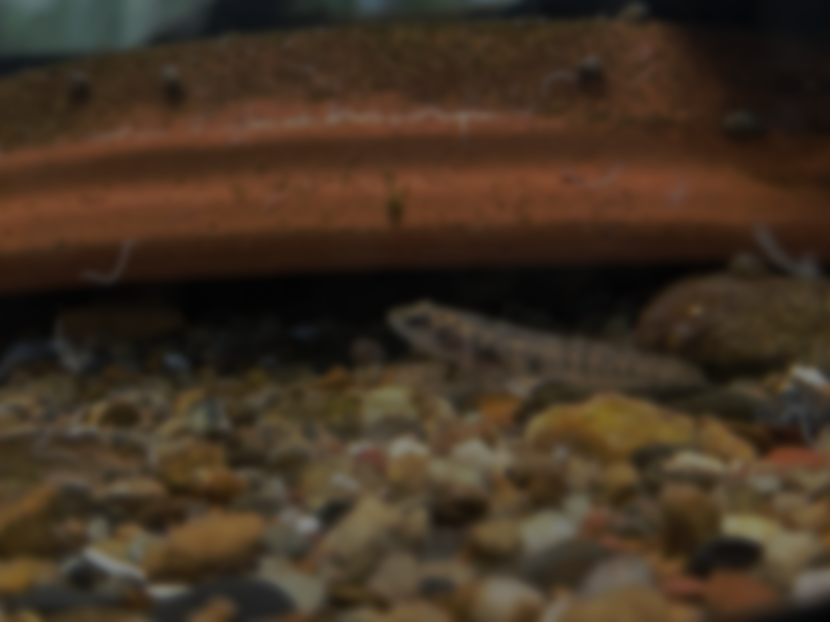
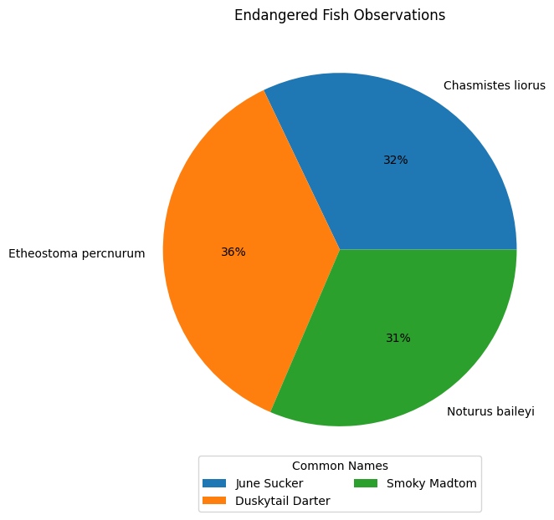
SECTION 6:
OBSERVATIONS OF ENDANGERED SPECIES: FISH

Slide 96
SECTION 6:
OBSERVATIONS OF ENDANGERED SPECIES: FISH
As with the previous category, the proportion of each ‘Endangered’ species in the ‘Fish’ category is balanced.
The ‘Etheostoma Percnurum’, or the Duskytail Darter, has the most observations in the category at 36%.
The ‘Noturus Baileyi’, or Smoky Madtom, has the least, making up 31% of the observations of endangered ‘Fish’ species.

Slide 97
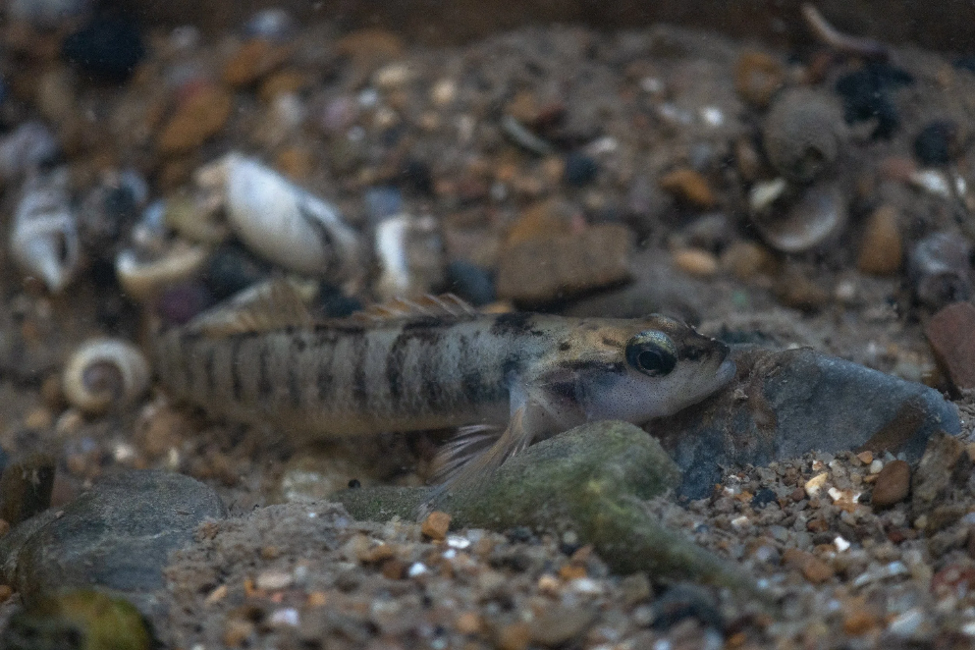
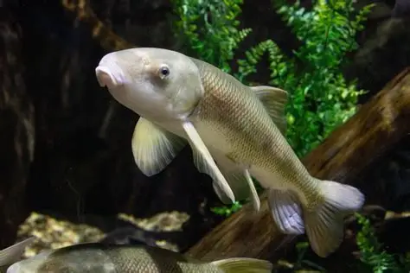
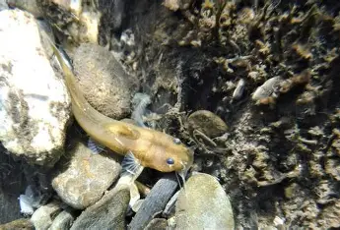
SECTION 6:
OBSERVATIONS OF ENDANGERED SPECIES: FISH
As with the previous category, the proportion of each ‘Endangered’ species in the ‘Fish’ category is balanced.
The ‘Etheostoma Percnurum’, or the Duskytail Darter, has the most observations in the category at 36%.
The ‘Noturus Baileyi’, or Smoky Madtom, has the least, making up 31% of the observations of endangered ‘Fish’ species.
Etheostoma Percnurum
Chasmistes Liorus
Noturus Baileyi

Slide 98
SECTION 6:
OBSERVATIONS OF ENDANGERED SPECIES: FISH
As with the previous category, the proportion of each ‘Endangered’ species in the ‘Fish’ category is balanced.
The ‘Etheostoma Percnurum’, or the Duskytail Darter, has the most observations in the category at 36%.
The ‘Noturus Baileyi’, or Smoky Madtom, has the least, making up 31% of the observations of endangered ‘Fish’ species.
Etheostoma Percnurum
Chasmistes Liorus
Noturus Baileyi

Slide 99
Etheostoma Percnurum
SECTION 6:
OBSERVATIONS OF ENDANGERED SPECIES: FISH
As with the previous category, the proportion of each ‘Endangered’ species in the ‘Fish’ category is balanced.
The ‘Etheostoma Percnurum’, or the Duskytail Darter, has the most observations in the category at 36%.
The ‘Noturus Baileyi’, or Smoky Madtom, has the least, making up 31% of the observations of endangered ‘Fish’ species.
Chasmistes Liorus
Noturus Baileyi

Slide 100
Etheostoma Percnurum
Chasmistes Liorus
SECTION 6:
OBSERVATIONS OF ENDANGERED SPECIES: FISH
As with the previous category, the proportion of each ‘Endangered’ species in the ‘Fish’ category is balanced.
The ‘Etheostoma Percnurum’, or the Duskytail Darter, has the most observations in the category at 36%.
The ‘Noturus Baileyi’, or Smoky Madtom, has the least, making up 31% of the observations of endangered ‘Fish’ species.
Noturus Baileyi

Slide 101
Which category has the most endangered species, and are species in some categories more likely to be endangered?

Slide 102
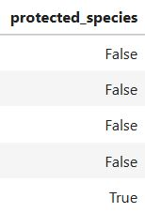
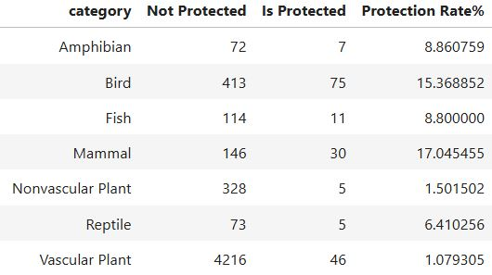
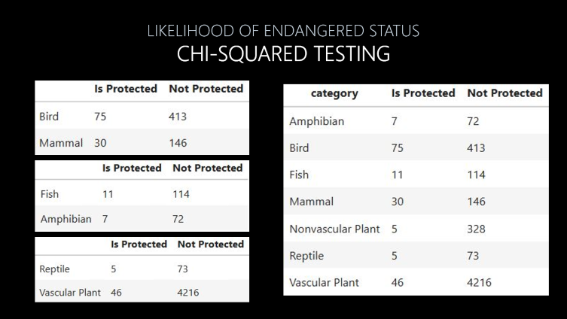
Which category has the most endangered species, and are species in some categories more likely to be endangered?
CHI-SQUARED TESTING
LIKELIHOOD OF ENDANGERED STATUS
1
2
3
In order to answer the question of likelihood of endangerment, we employed the use of chi-squared testing. We investigated if there was a significant difference in the percentage or rate of protected species between the categories. This is the process we followed:
CREATE A COLUMN FOR THE PROTECTION STATUS OF EACH CATEGORY IN THE DATASET
CALCULATE A RATE OF PROTECTION FOR EACH CATEGORY
CREATE CONTINGENCY TABLES WITH PROTECTION RATES OF CATEGORIES AND PERFORM CHI-SQUARED TESTS

Slide 103
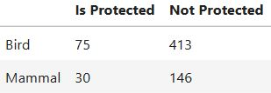
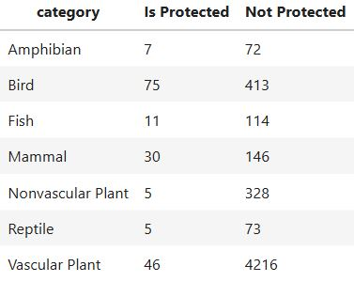
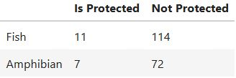
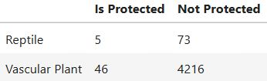
LIKELIHOOD OF ENDANGERED STATUS
CHI-SQUARED TESTING
"Are species in some categories more likely to be endangered?“
Our null hypothesis is that there is no difference between the rate of protection required for each category, while our alternative hypothesis is that there is a difference between the rate of protection required for each category.

Slide 104
LIKELIHOOD OF ENDANGERED STATUS
CHI-SQUARED TESTING
"Are species in some categories more likely to be endangered?“
Our null hypothesis is that there is no difference between the rate of protection required for each category, while our alternative hypothesis is that there is a difference between the rate of protection required for each category.

Slide 105
LIKELIHOOD OF ENDANGERED STATUS
CHI-SQUARED TESTING
"Are species in some categories more likely to be endangered?“
Our null hypothesis is that there is no difference between the rate of protection required for each category, while our alternative hypothesis is that there is a difference between the rate of protection required for each category.
Returned p-value: 0.01 (1%)
Less than the standard significance level of 0.05. Unlikely to be due to random chance.
Rejected null hypothesis.
Returned p-value: 1.00 (100%)
Higher than the standard significance level of 0.05.
Very likely to be due to random chance.
Null hypothesis could not be rejected.
Returned p-value: 0.00 (0%)
Below the standard significance level of 0.05.
Unlikely to be due to random chance.
Rejected the null hypothesis.

Slide 106
LIKELIHOOD OF ENDANGERED STATUS
CHI-SQUARED TESTING
"Are species in some categories more likely to be endangered?“
Our null hypothesis is that there is no difference between the rate of protection required for each category, while our alternative hypothesis is that there is a difference between the rate of protection required for each category.
Returned p-value: 0.01 (1%)
Less than the standard significance level of 0.05. Unlikely to be due to random chance.
Rejected null hypothesis.
Returned p-value: 1.00 (100%)
Higher than the standard significance level of 0.05.
Very likely to be due to random chance.
Null hypothesis could not be rejected.
Returned p-value: 0.00 (0%)
Below the standard significance level of 0.05.
Unlikely to be due to random chance.
Rejected the null hypothesis.

Slide 107
LIKELIHOOD OF ENDANGERED STATUS
CHI-SQUARED TESTING
Returned p-value: 0.01 (1%)
Less than the standard significance level of 0.05. Unlikely to be due to random chance.
Rejected null hypothesis.
Finally, we performed a chi-squared test on a contingency table with all the categories and protection rates, with these results:
Returned p-value: 0.00 (0%)
Below the standard significance level of 0.05.
Very unlikely to be due to random chance.
Rejected the null hypothesis.
Overall significant relationship between category and protection status.
We therefore concluded that some species are more likely to be endangered or in need of protection than others.
Returned p-value: 1.00 (100%)
Higher than the standard significance level of 0.05.
Very likely to be due to random chance.
Null hypothesis could not be rejected.
Returned p-value: 0.00 (0%)
Below the standard significance level of 0.05.
Unlikely to be due to random chance.
Rejected the null hypothesis.

Slide 108
LIKELIHOOD OF ENDANGERED STATUS
CHI-SQUARED TESTING
Returned p-value: 0.01 (1%)
Less than the standard significance level of 0.05. Unlikely to be due to random chance.
Rejected null hypothesis.
Finally, we performed a chi-squared test on a contingency table with all the categories and protection rates, with these results:
Returned p-value: 0.00 (0%)
Below the standard significance level of 0.05.
Very unlikely to be due to random chance.
Rejected the null hypothesis.
Overall significant relationship between category and protection status.
We therefore concluded that some species are more likely to be endangered or in need of protection than others.
Returned p-value: 1.00 (100%)
Higher than the standard significance level of 0.05.
Very likely to be due to random chance.
Null hypothesis could not be rejected.
Returned p-value: 0.00 (0%)
Below the standard significance level of 0.05.
Unlikely to be due to random chance.
Rejected the null hypothesis.

Slide 109
Project Overview
INTRODUCTION
Setting the project goals and introducing the data. Posing questions for analysis to answer.
CLEANING
Cleaning the data, deleting duplicates, and merging into one DataFrame.
CONCLUSION
Summarising findings and answers to the main questions.
2
4
1
3
EXPLORATION
Initialising the libraries and loading data into DataFrames. Exploring the unedited, raw DataFrames.
ANALYSIS
Beginning EDA (Exploratory Data Analysis). Analysing and visualising main points to answer questions.

Slide 110



Slide 111
CONCLUSION

Slide 112
CONCLUSION

Slide 113
CONCLUSION

Slide 114
CONCLUSION
This presentation covered the data, analysis and calculations used in this portfolio project to investigate biodiversity in national parks. As a result of the analysis and calculations of protection rates, we concluded that mammal species are the most likely to become endangered across the four parks.
Possible suggestions to conservation groups include investigation of the common habitats and diets of the endangered species in the parks. Observations of the species could also be recorded with the dates of sightings, to allow analysis of species decline or recovery over time.
Thank you to all who contributed to this project through error fixes and other guidance.

